Slide 1
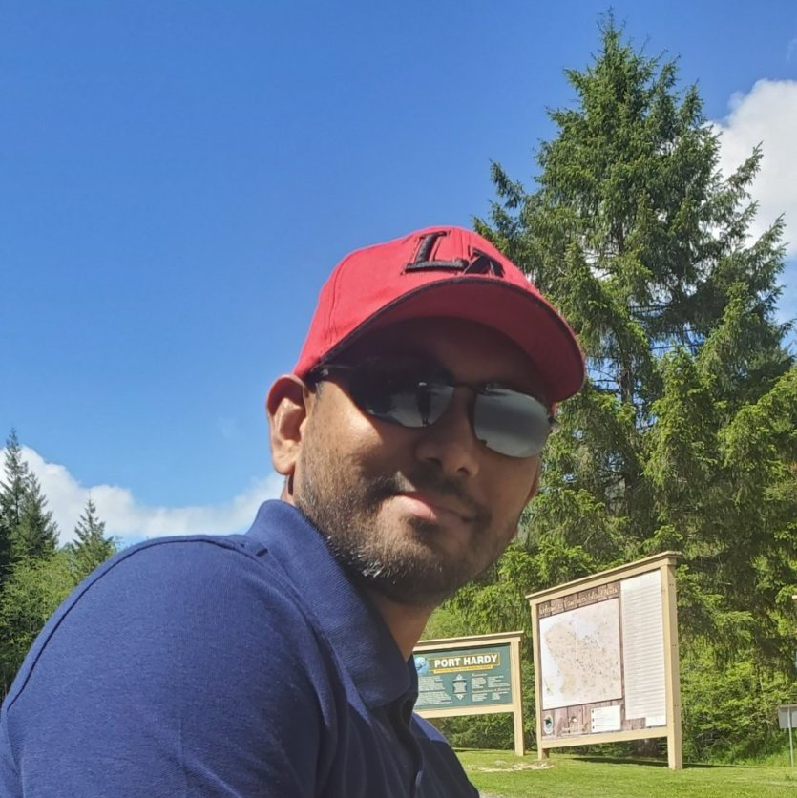
Prishan
Fernando
RELEVANT EXPERIENCE
Technical Architect / Point Click Care Assisted with Product to Cash discovery to figure business processes and optimal technical solution for PCC Lead the new DevOps process and assist evaluating product vendors, branching and environment strategies Provided Technical Architecture Oversite for the BAU Projects and led the design and implementation work streams
SKILLS
Technical & Solution Architecture Technology Architecture & Strategy Salesforce DevOps​ Digital Transformation & Delivery Data Architecture Tech Audit Generative AI LLM & Vector Database
INDUSTRY EXPERIENCE
Government – Provincial Manufacturing E-Commerce Technology Real Estate Healthcare Business Consulting & Services
EDUCATION/CERTIFICATION
BSc in Computer Science SF Platform Developer I SF Experience Cloud Consultant SF AI Associate SF Administrator Salesforce Certified Business Analyst Certified Development Lifecycle and Deployment Designer
Technical Architect - Fraser Health Solution Facilitated Technical Discovery Sessions for FHS provider management. Developed Business Capability maps and product roadmaps. Created Proof of Concepts (POCs) to showcase possibilities for stakeholders. Specialized in Salesforce Experience Cloud, Service Cloud, and Sales Cloud.
Technical Architect - Investor Group Engineered a Custom Secure File sharing application for document exchange between clients and advisors. Implemented integration between Splash and Salesforce to synchronize Events. Expertise in Salesforce Experience Cloud, Service Cloud, Sales Cloud, Custom Apex, Lightning Web Components (LWC), Aura, and third-party integrations.
Director Global Salesforce Vancouver
Prishan is a seasoned leader and Program Architect with over two decades of software development experience and over a decade of Salesforce expertise. He has a strong focus on technical architecture and leadership, excelling in the development of custom applications within the Salesforce ecosystem. Prishan’s proficiency in building tailored solutions has significantly impacted client satisfaction and business outcomes.
Prishan has consistently demonstrated his ability to architect and deliver complex solutions across multiple business units, systems, and technologies. He collaborates closely with both business and technology stakeholders, as well as executives, to co-create and implement solutions within a multi-vendor environment. His leadership has been pivotal in successfully leading numerous system migration and digital transformation programs for clients ranging from small businesses to enterprises, enabling them to achieve their business goals, drive operational excellence, and foster technological innovation.
Program/Technical Architect – Motorola Solutions Inc: Responsible for the overall Technical architecture and delivery of an M&A program, which merged three companies into a single salesforce org and SAP Instance. Lead the design of Salesforce data modeling, extend SAP integrations to support multi-brand capabilities. Salesforce capabilities including Service Cloud, Sales Cloud, Experience Cloud, CPQ, E-Commerce, Single Sing On, Data transformation and Migrations Responsible for the overall Technical architecture and delivery of an e-commerce transformation program, including the deployment of net new E-Commerce channel, (CPQ), Customer support community capabilities, Partner community, and SAP Integrations. This program was the first to ever integrate seamlessly Salesforce Commerce & CPQ engines. . This was successfully deployed to 1,000+ staff and over 18,000+ partners.

Slide 2
Prishan Fernando cont'd
RELEVANT EXPERIENCE
Technical Architect / Altasian Led technical roadmap sessions, defining the strategic direction for Sales Cloud and Partner Relationship Management (PRM) enhancements. Designed and implemented system and integration solutions to enhance Sales Cloud and PRM functionalities. Guided the Salesforce delivery team to successfully implement new capabilities on PRM. Ensured the alignment of technical solutions with business goals, improving overall system efficiency and user experience.
Technical Architect / Rennie As the main technical architect, I led the integration design and data migration activities, ensuring best practices were implemented. Led the development team and business analysts, providing essential support to align with project goals. Successfully completed the project on time and to quality standards, offering post-launch support and iterative improvements based on client feedback. Recognized as a trusted advisor by the client, the project's success led to additional collaboration and opportunities.

